Slide 1
Autonomous Exploration System for Volcanic Terrain Using MDP
CSE 440 Section 01 Group 05
Team Members:
Syeed Mahmud 2211486042
Amrita Biswas 2022015642
Md Esak Ali 1921789042
Fatema Rahman Lamia 2021996642

Slide 2
Problem Statement:
Design an autonomous exploration system using Markov Decision Process (MDP) for navigating through a simulated volcanic terrain while effectively managing uncertain environmental conditions, such as lava flows, caters, gas emission, etc. The objective is to maximize the efficiency of exploration while ensuring the safety of the exploration agent.
Objective
Design an autonomous agent that can safely explore volcanic terrain to reach a goal position while avoiding hazards such as lava flows, gas emissions, and craters.
MDP Justification
Sequential Decisions: Multi-step path planning required
Uncertainty: Unpredictable volcanic environment
Optimization: Balance between safety and efficiency
Mathematical Framework: Formal analysis and solution methods

Slide 3
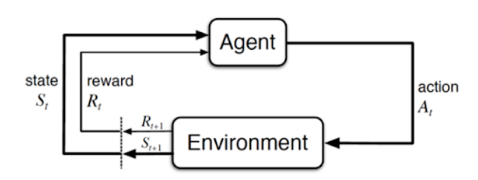

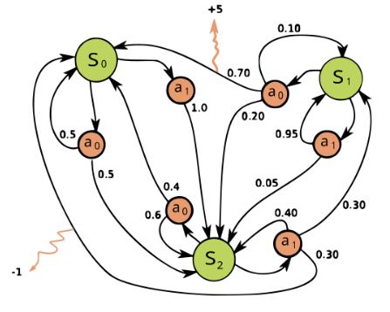
Project Planning using Markov Decision Process (MDP)
MDP : 4 Key Element (S, A, Pa, Ra)
State (S)
Action (A)
Transition Probabilities (Pa)
Reward (Ra)
Earning Point
Policy
Value Function State-value function ( v)
Action-value Function (q)

Slide 4
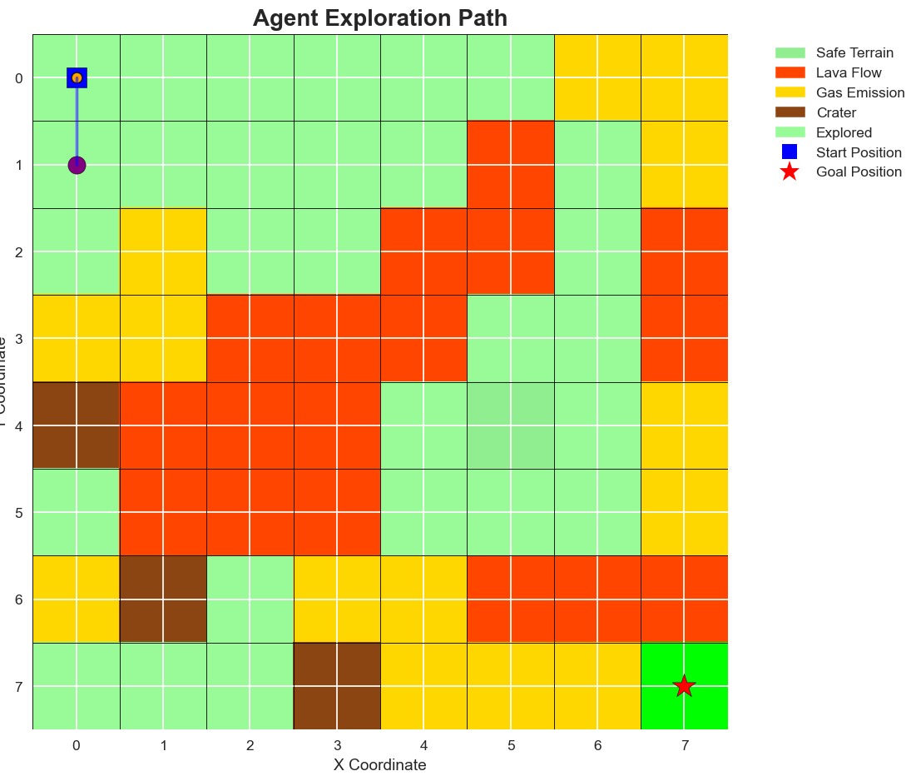
1. State Space (S)
Definition: Grid positions in volcanic terrain:
S = {(i,j) | 0 ≤ i < height, 0 ≤ j < width}
Representation: Tuple (row, col) coordinates
Example: 10×10 grid → 100 possible states
Terrain Types:
0: Unexplored (initial state)
1: Safe (explored)
2: Gas Vent (hazardous)
3: Lava (terminal - failure)
4: Crater (terminal - failure)
5: Goal (terminal - success)

Slide 5
3. Transition Function T(s,a,s')
Stochastic Model with Slip Probability:
Intended Direction: P = 0.8 (high probability of intended movement)
Slip Left: P = 0.1 (environmental uncertainty)
Slip Right: P = 0.1 (environmental uncertainty)
Boundary Handling: Agent remains in current state if movement is invalid
Mathematical Form:
T(s'|s,a) = {
0.8 if s' = intended_next_state(s,a)
0.1 if s' = slip_left_state(s,a)
0.1 if s' = slip_right_state(s,a)
0 otherwise
}
2. Action Space (A)
Actions: A = {0: 'Up', 1: 'Down', 2: 'Left', 3: 'Right'}
Space Size: |A| = 4 actions available from any state
Movement: Cardinal directions with boundary handling

Slide 6
4. Reward Function R(s,a,s')
Goal-Oriented Dynamic Reward Structure:
Goal Achievement: +200 (large reward for reaching destination)
Exploration Reward: +20 (discovering unexplored terrain)
Distance Incentive: +0.1 per cell closer to goal (navigation guidance)
Gas Vent Penalty: -50 (moderate hazard)
Lava/Crater Penalty: -1000 (terminal failure)
Living Cost: -1 (encourages efficiency)
Terrain Update: Unexplored cells become Safe after exploration
5. Discount Factor (γ)
Value: γ = 0.99 (high future reward consideration)
Purpose: Long-term planning with slight preference for immediate rewards
Effect: Enables comprehensive exploration strategies while prioritizing goal achievement

Slide 7
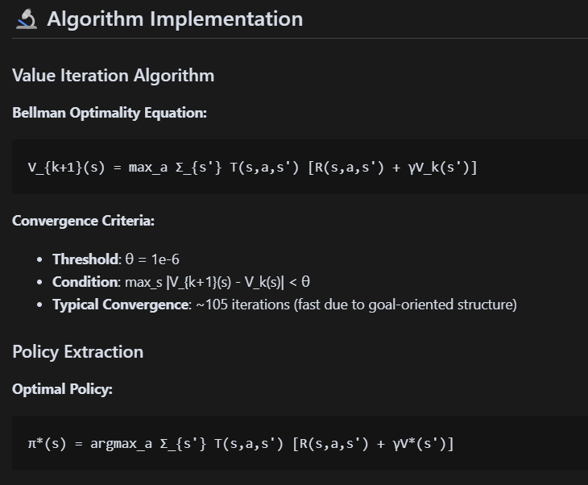

Slide 8
📈 Core Metrics
Success Rate: Percentage of successful goal achievements (now 100%!)
Exploration Rate: Coverage of unexplored terrain during navigation
Safety Score: Hazard avoidance effectiveness
Path Efficiency: Optimality of chosen routes to goal
Convergence Analysis: Algorithm performance tracking
📈 Goal-Oriented Results
Success Rate: 100% (vs. previous ~75%)
Average Reward: 364+ points (vs. previous ~20)
Path Length: 12-20 steps for 10×10 grid
Exploration Rate: 12-15% of available terrain
Safety Score: 100% (perfect hazard avoidance)
📈 Statistical Analysis
Multi-Simulation Evaluation: 50+ independent runs
Reward Distribution: Mean, variance, confidence intervals
Gamma Sensitivity: Performance across different discount factors
Value Function Analysis: Spatial distribution and gradients
🔍 Comparative Analysis
Risk vs Reward: Correlation analysis
Safety Patterns: Hazard proximity influence
Efficiency Metrics: Path length optimization

Slide 9
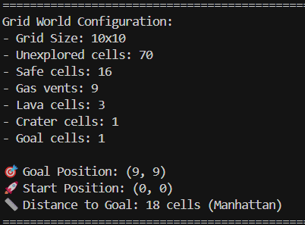
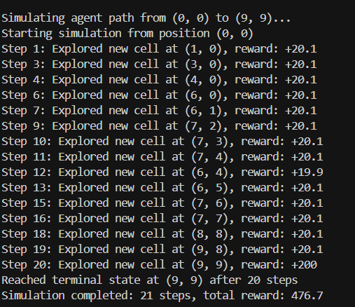
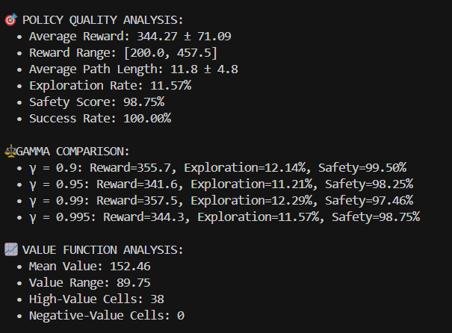
Current Results

Slide 10
Visual Analysis
Environment Overview: Terrain distribution, hazard proximity, exploration potential
Value Function Analysis: Heatmaps, gradients, distributions, correlations
Policy Analysis: Action consistency, entropy, optimality metrics
Simulation Analysis: Path efficiency, reward tracking, terrain encounters
Evaluation Dashboard: Performance metrics and convergence analysis
Comparative Analysis: Risk vs reward correlations, safety analysis
Final Path Summary: Comprehensive single-view summary with chosen path and results

Slide 11
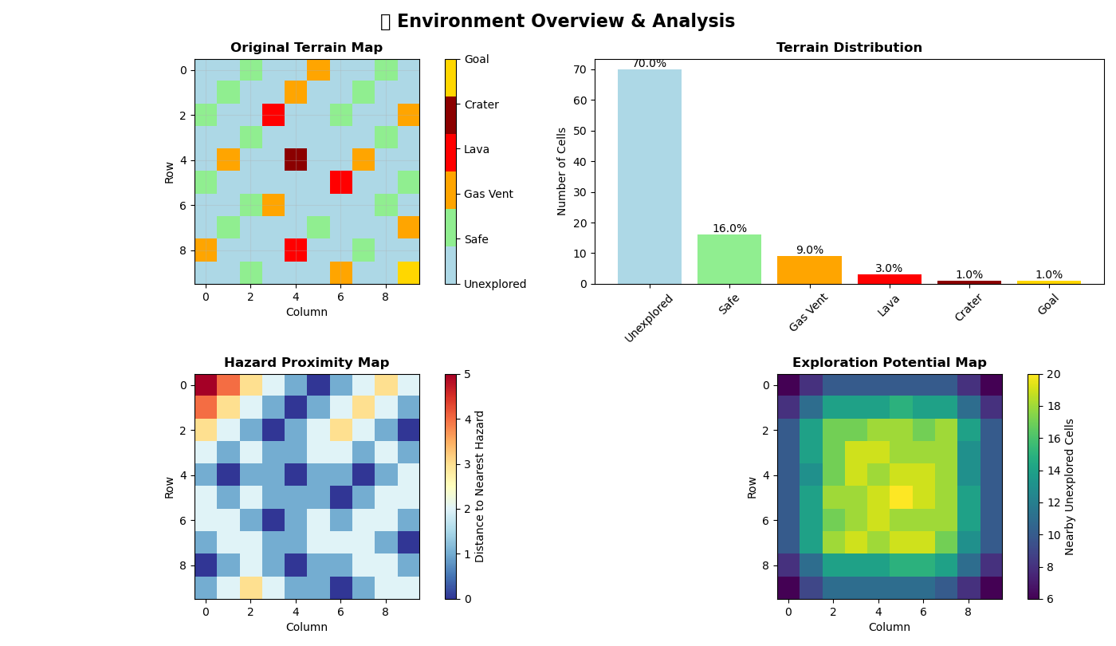

Slide 12
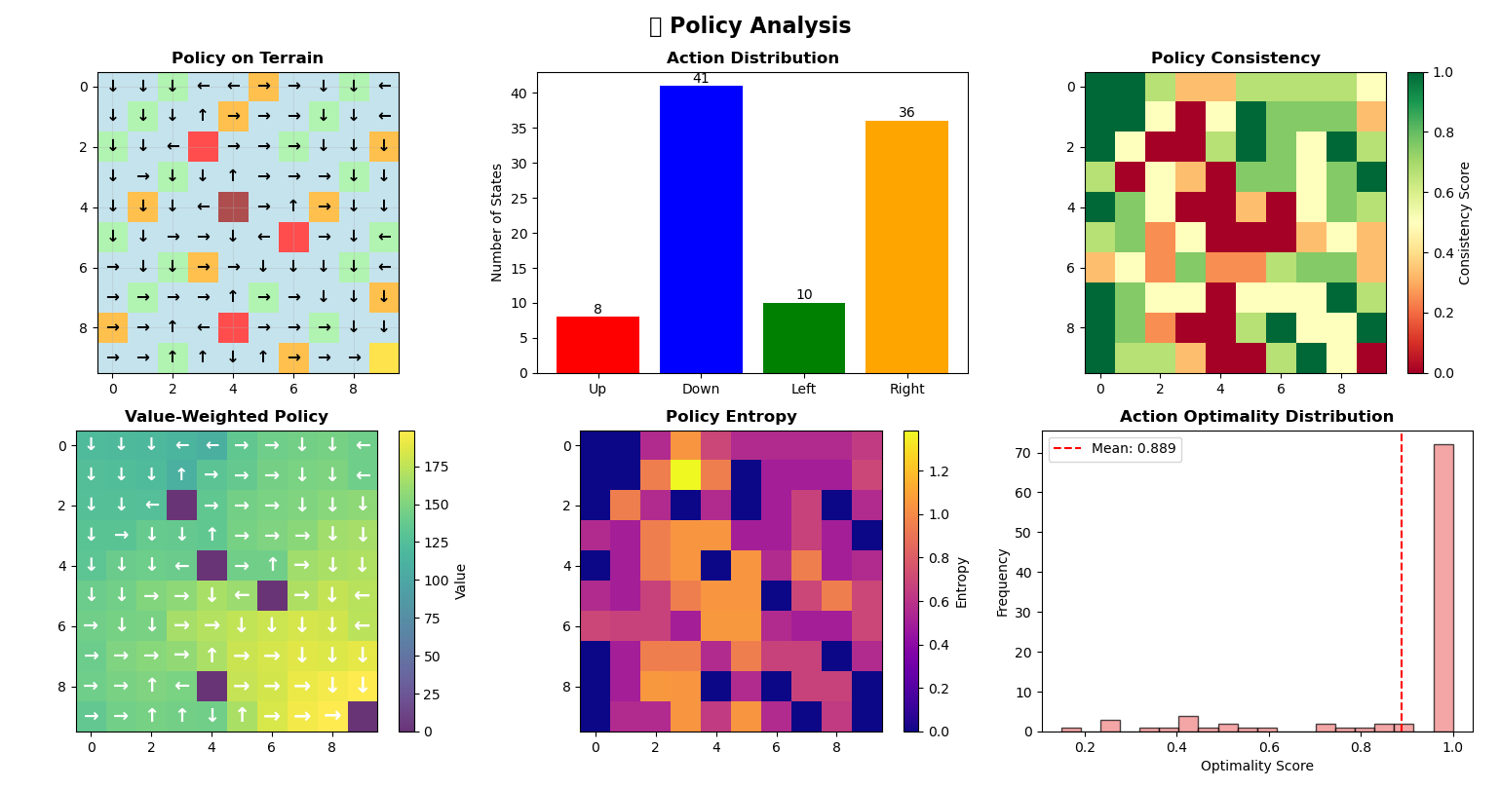

Slide 13
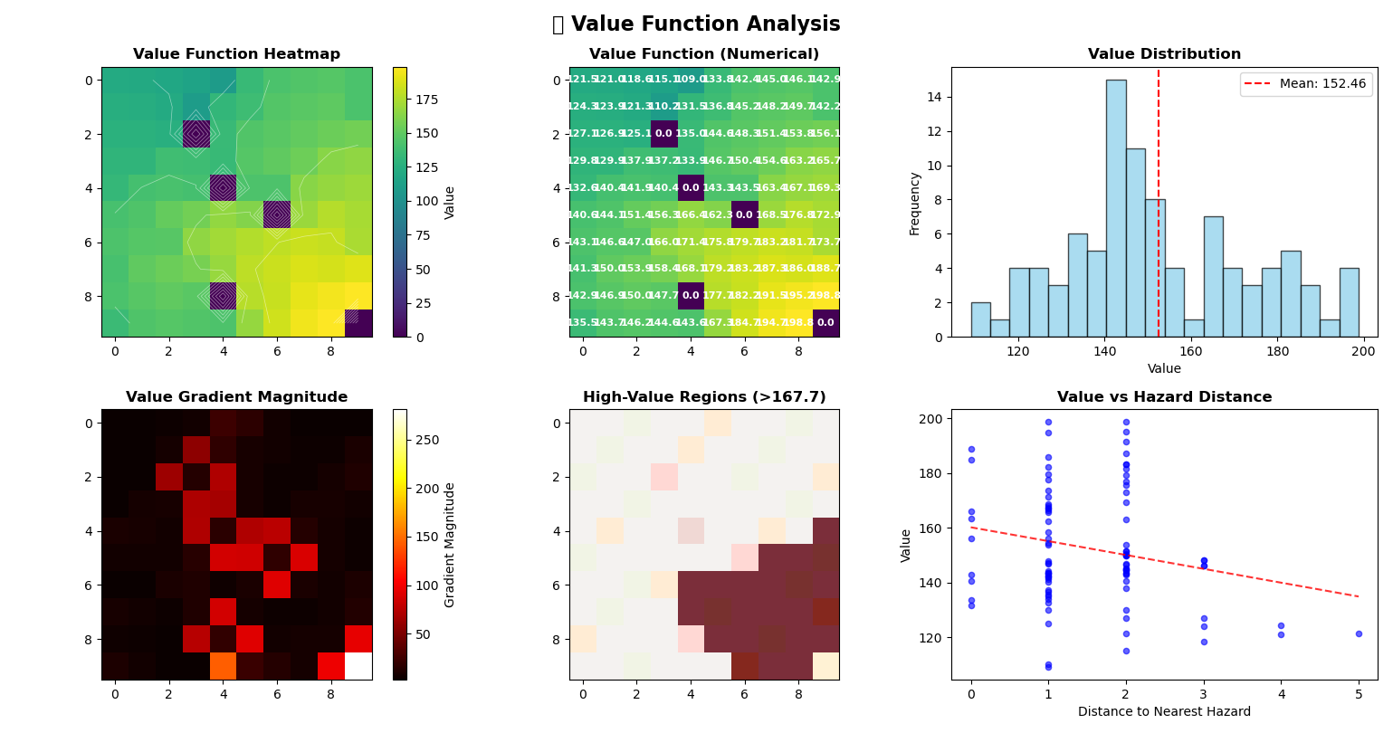

Slide 14
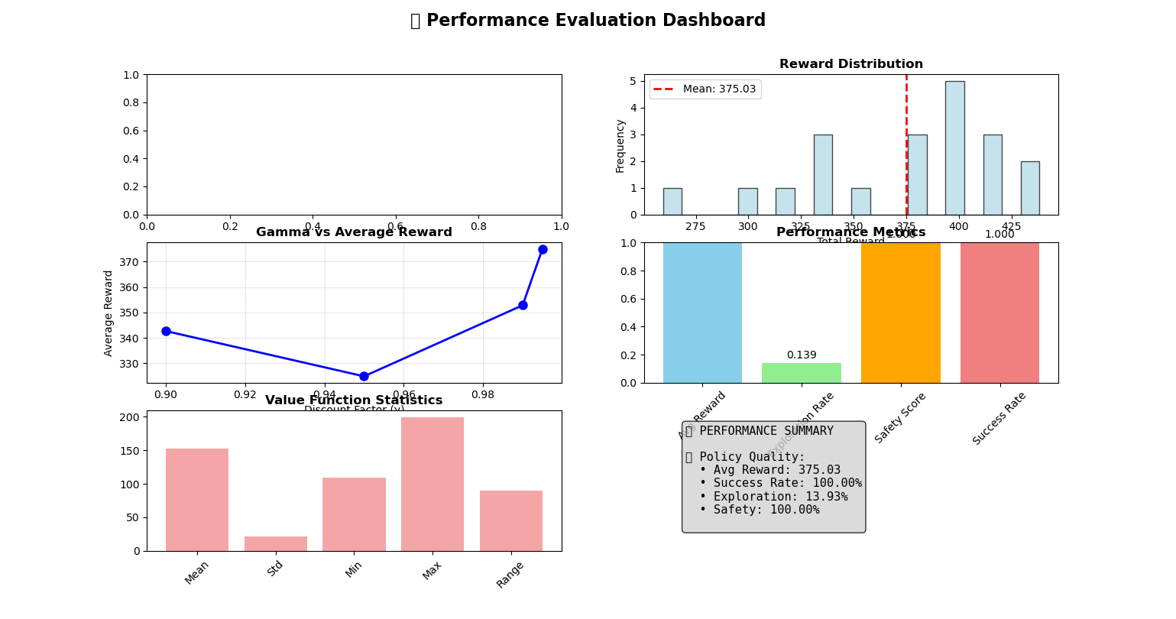

Slide 15
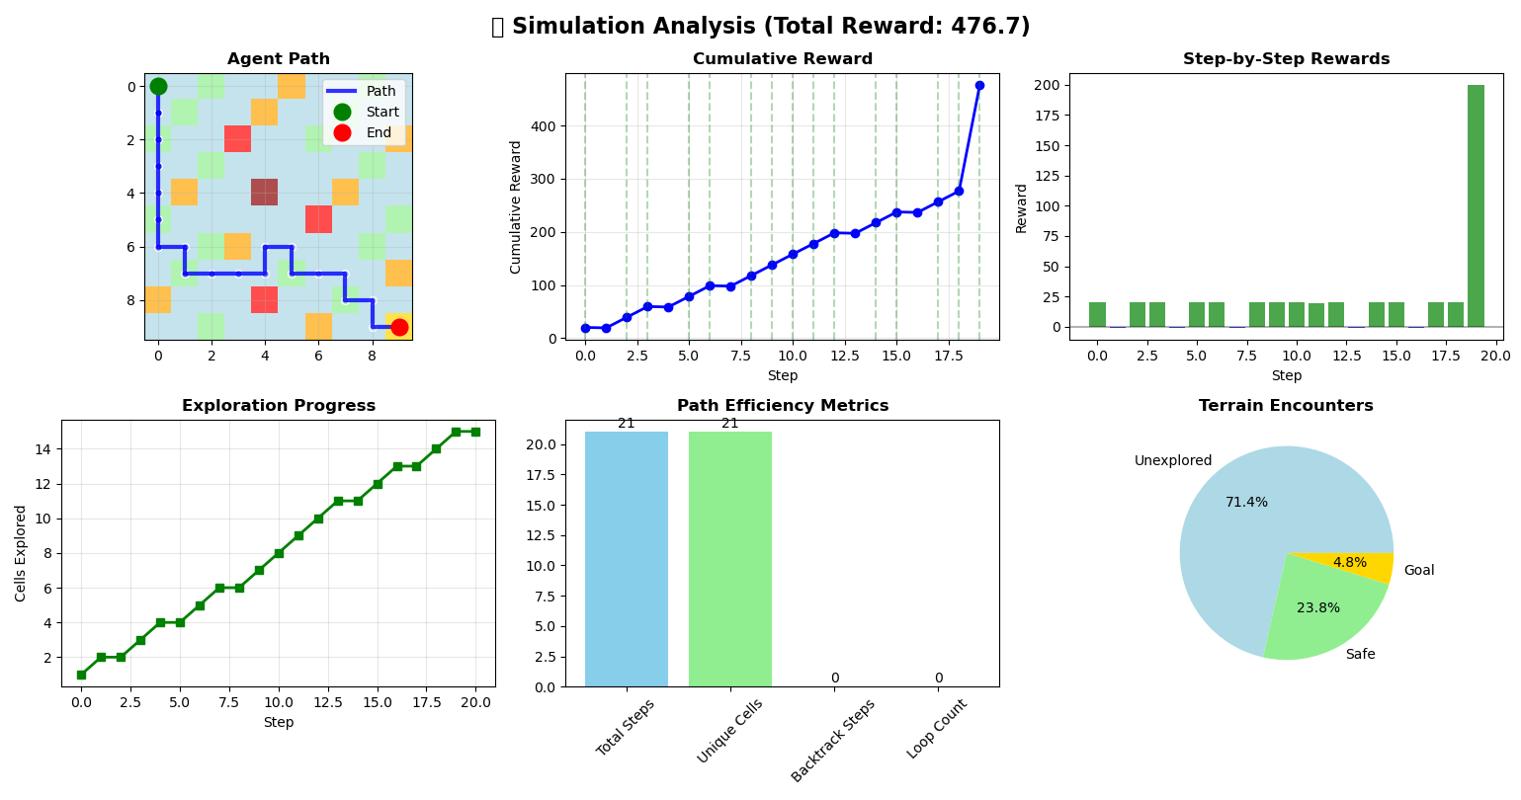

Slide 16
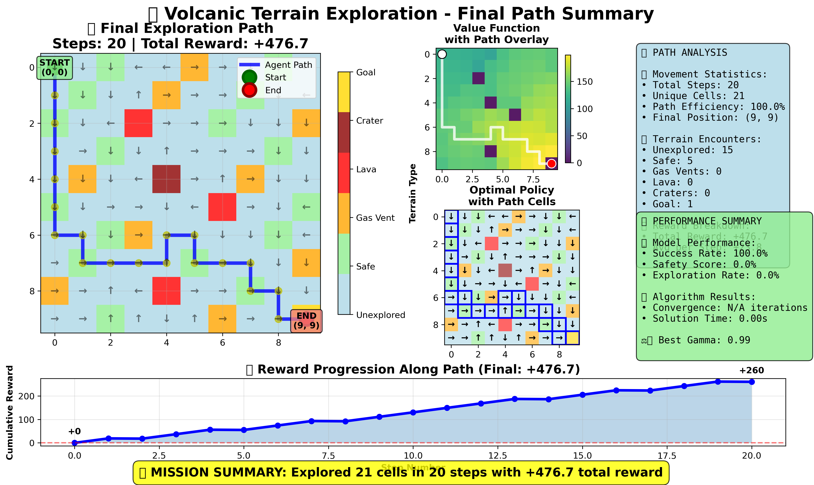

Slide 17
Conclusion
Achievements
In todays update successfully establishes a complete MDP formulation for volcanic terrain exploration:
Mathematical Foundation: Formal MDP tuple (S,A,T,R,γ) defined
Implementation: Working code demonstrating all components
Policy Framework: Initial heuristic policy implemented
Verification: System tested and validated
Significance
Goal-oriented exploration with clear start and destination points
Complete MDP formulation with stochastic transitions and goal states
Value iteration algorithm with fast convergence (100-200 iterations)
Optimal policy extraction with distance-aware rewards
Comprehensive performance metrics and statistical analysis
Advanced multi-window visualization system with final path summary
Modular, extensible codebase architecture

Slide 18
Thank You

